Slide 1
Fake News Detector for Students
CAPSTONE PROJECT
Presented By:
1. Rohan S - PESITM - CS&E

Slide 2
OUTLINE
Problem Statement
System Development Approach
Algorithm & Deployment
Result
Conclusion
Future Scope
References

Slide 3
Problem Statement
In the digital age, misinformation spreads rapidly through online platforms, leading to confusion, panic, and loss of trust in media. Students and the general public often struggle to differentiate between credible news and fake content.
Problem: There is a need for an automated, accessible, and accurate system to analyze news articles, verify their credibility, and detect potential fake news to promote media literacy and informed decision-making.

Slide 4
System Approach
Frontend | Gradio app for user interaction (chat UI, input/output display)
Backend | Python logic to handle chat flow, model inference, and session state
Model Engine | LLaMA-based model - HuggingFace Transformers summarization model (sshleifer/distilbart-cnn-12-6) Fake news detection model (mrm8488/bert-tiny-finetuned-fake-news-detection)
Libraries/Frameworks | gradio – for user interface newspaper3k – for article extraction transformers – for summarization and classification re, datetime – for processing and timestamps
Deployment Platform | Localhost / Cloud hosting - Hugging faces spaces

Slide 5
Algorithm & Deployment
Step 1: User Authentication
Input: Username, Password
Process:
The system checks if the entered username exists.
If the password matches the stored one, the user is marked as logged in.
Else login fails and error is returned.
Step 2: Article Input and Preprocessing
Input: URL of an online news article
Process:
The system checks if the URL starts with http or https.
The newspaper3k library downloads and parses the article.
The extracted article text is validated for minimum length (≥100 characters).

Slide 6
Algorithm & Deployment
Step 3: Summarization
Input: Parsed article text
Process:
The first 1024 characters of the article text are passed to a pre-trained transformer model (sshleifer/distilbart-cnn-12-6).
The model generates a concise summary using a pipeline("summarization").
Step 4: Source Credibility Check
Input: Article URL
Process:
Domain is extracted using regular expressions.
The domain is compared with a static list of known reliable sources (e.g., bbc.com, nytimes.com).
If matched, the source is marked as trusted, else unverified.

Slide 7
Algorithm & Deployment
Step 5: Fake News Detection
Input: Summary text
Process: Confidence score is also extracted from the model output.
Step 6: Session-Based History Tracking
Input: Analysis results and current username
Process: The analysis (URL, summary, credibility, fake news result, timestamp) is appended to the user’s session history stored in user_sessions.
Step 7: Logout Functionality
Input: Logout
Process: The system removes the user's session from memory.

Slide 8
Algorithm & Deployment
Environment Setup
Language: Python 3.8+
Interface: Gradio
Libraries Used:
gradio (for UI)
transformers (for model inference)
newspaper3k (for article parsing)
re, datetime (for utility functions)
Deployment Architecture
User → Web Browser → Gradio Interface → Python Backend
↘ ↙
Transformer Models (via Hugging Face)
No external database is used
All user data and session states are managed using in-memory Python dictionaries.
On server restart, all session history is reset.

Slide 9
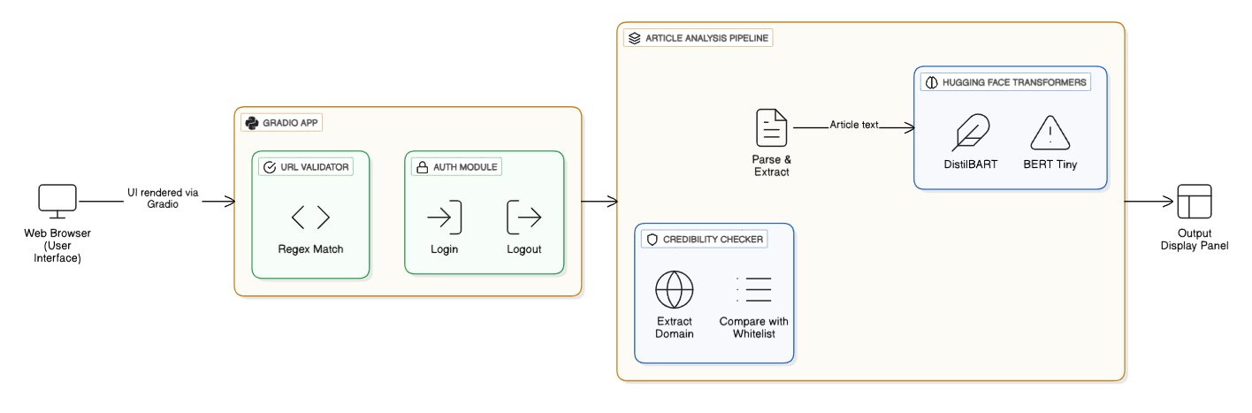
Algorithm & Deployment
System Architecture

Slide 10
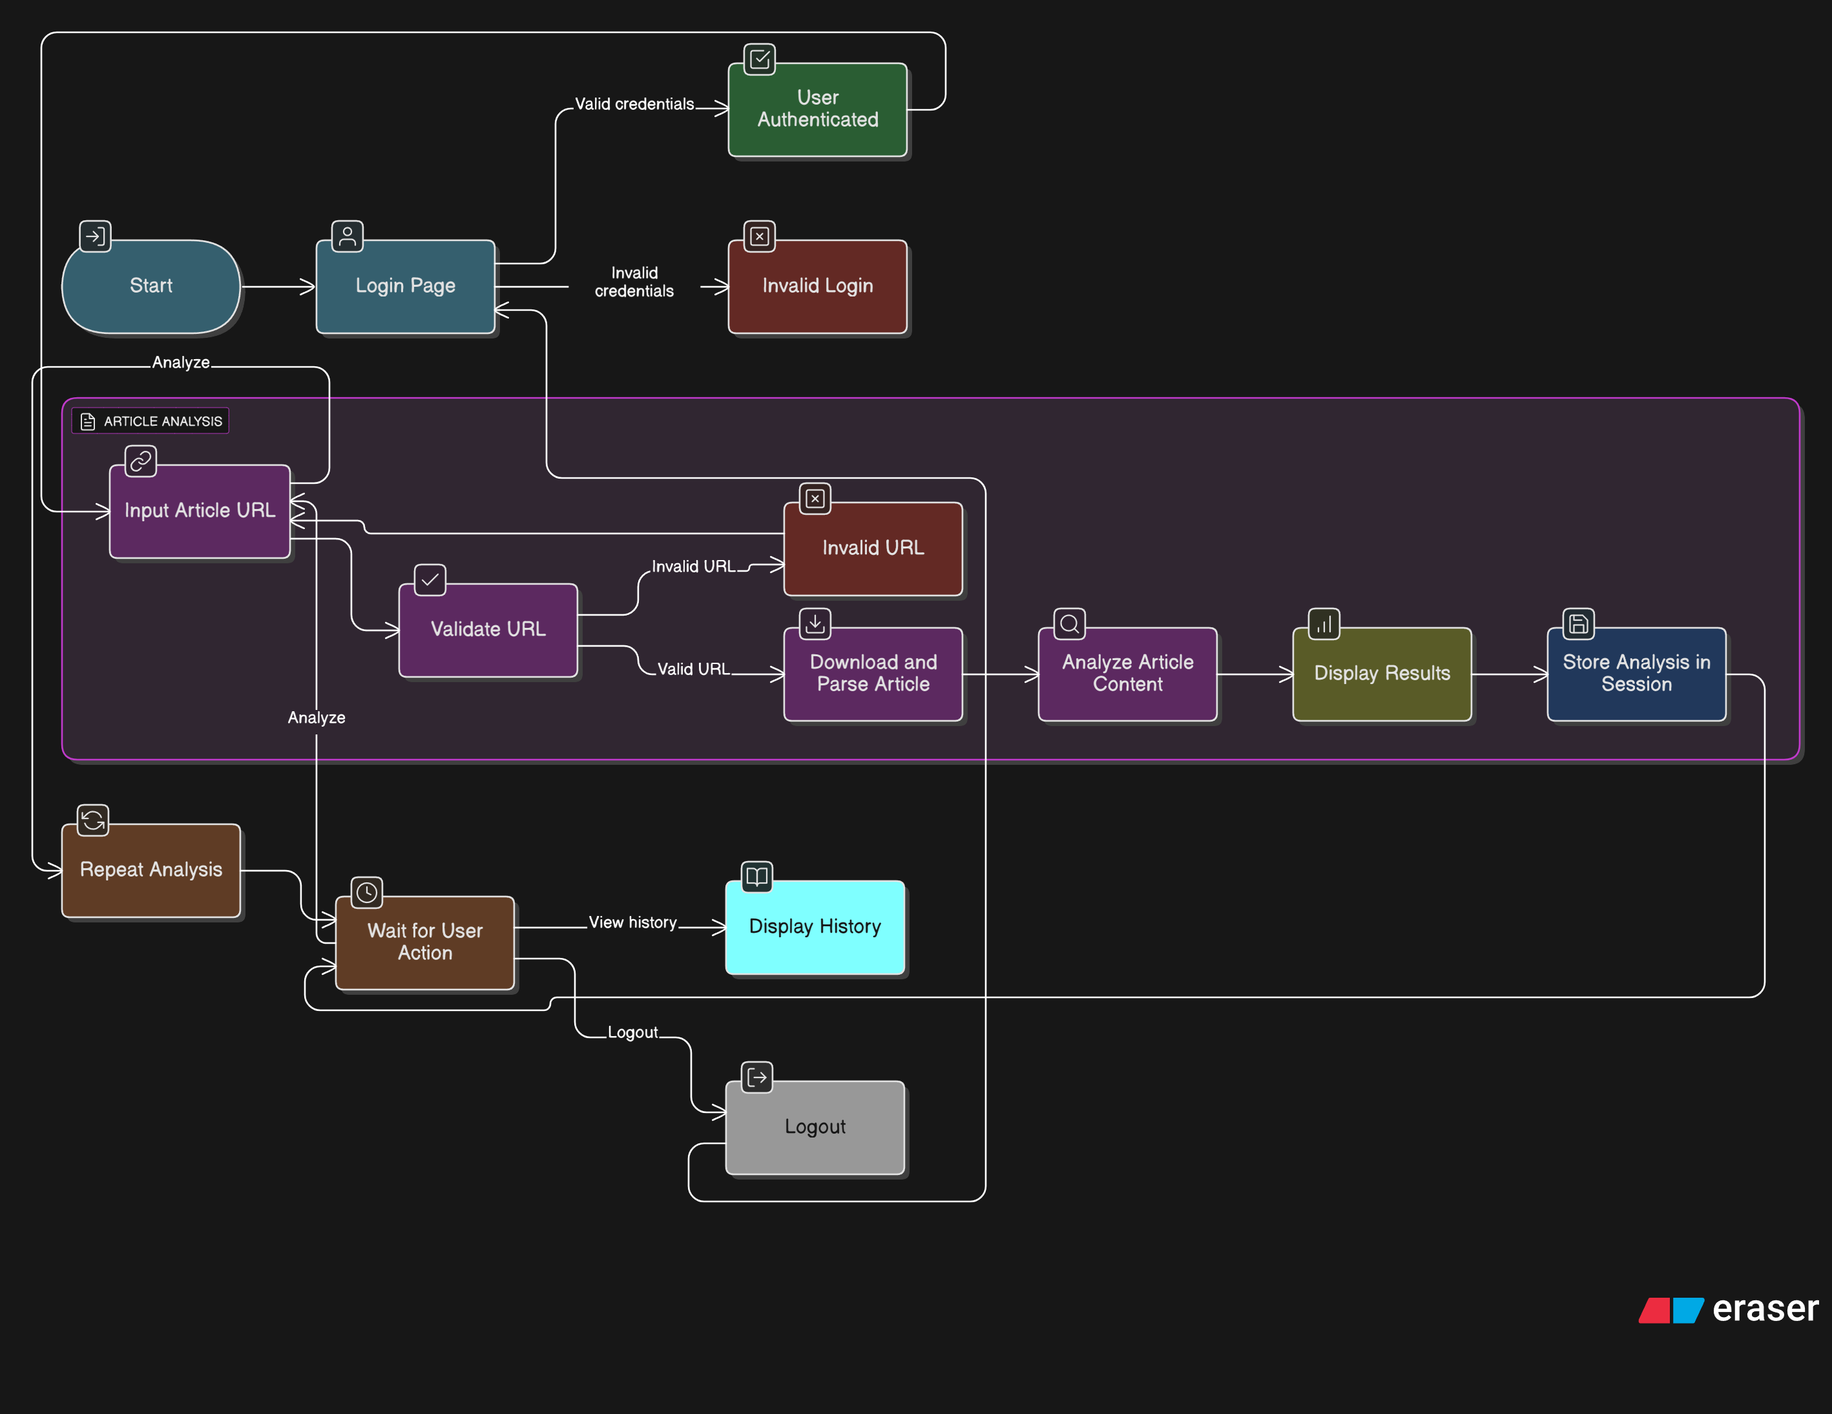
Algorithm & Deployment
State Diagram

Slide 11
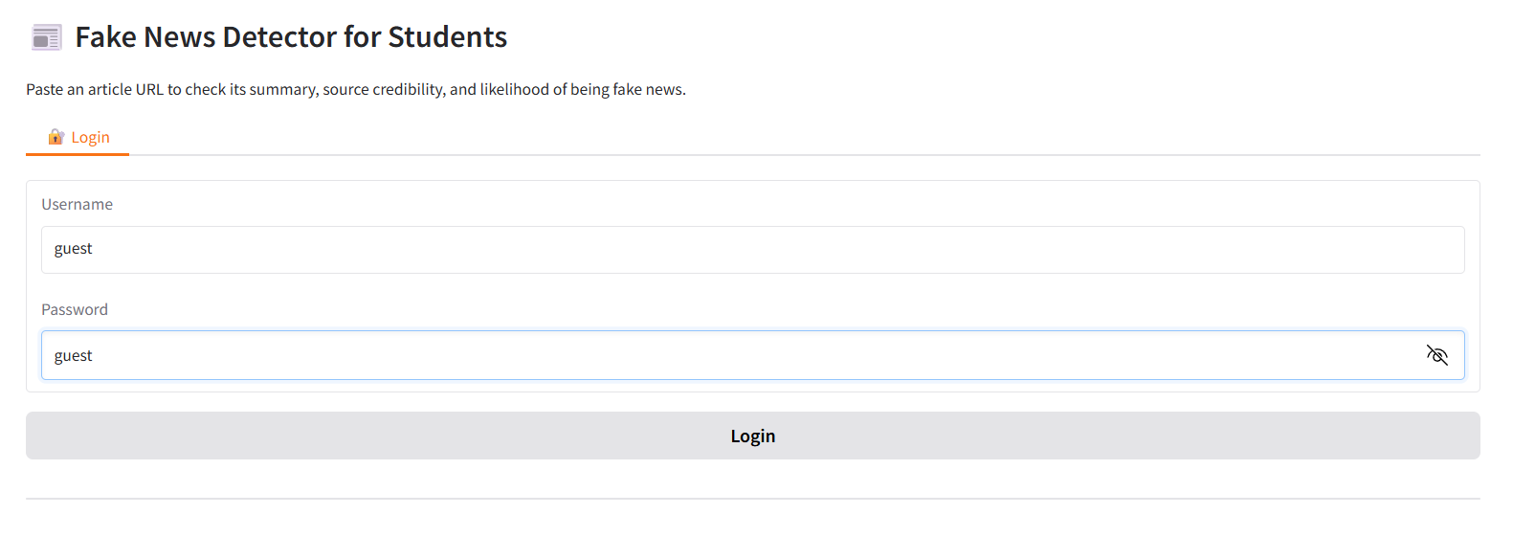
Result
User Login page

Slide 12
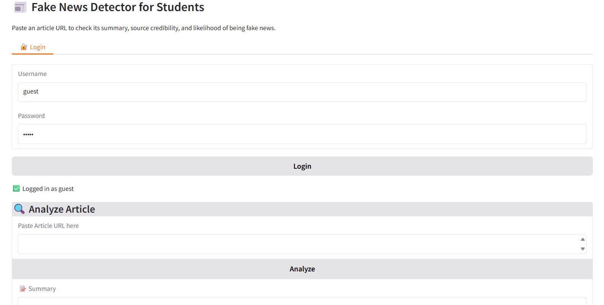
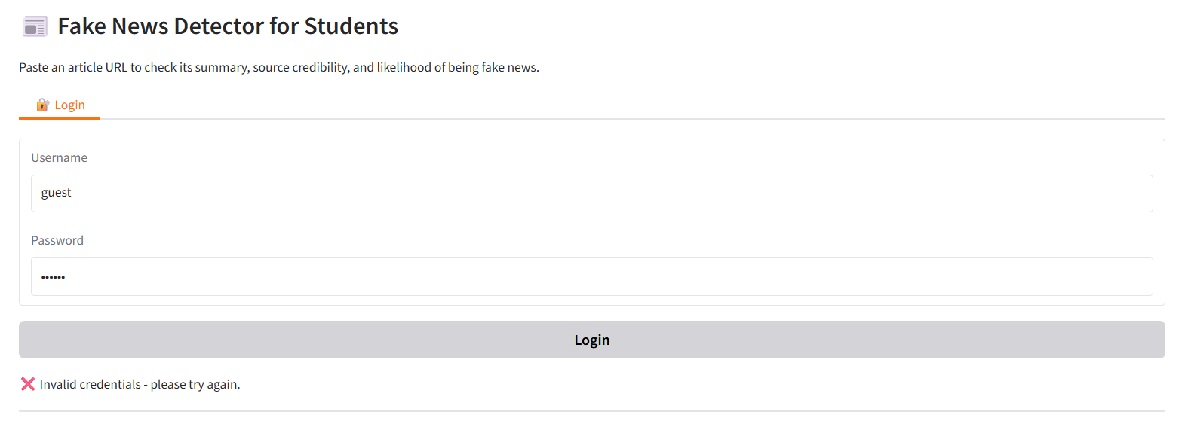
Result
Different login scenarios: correct and incorrect passwords

Slide 13
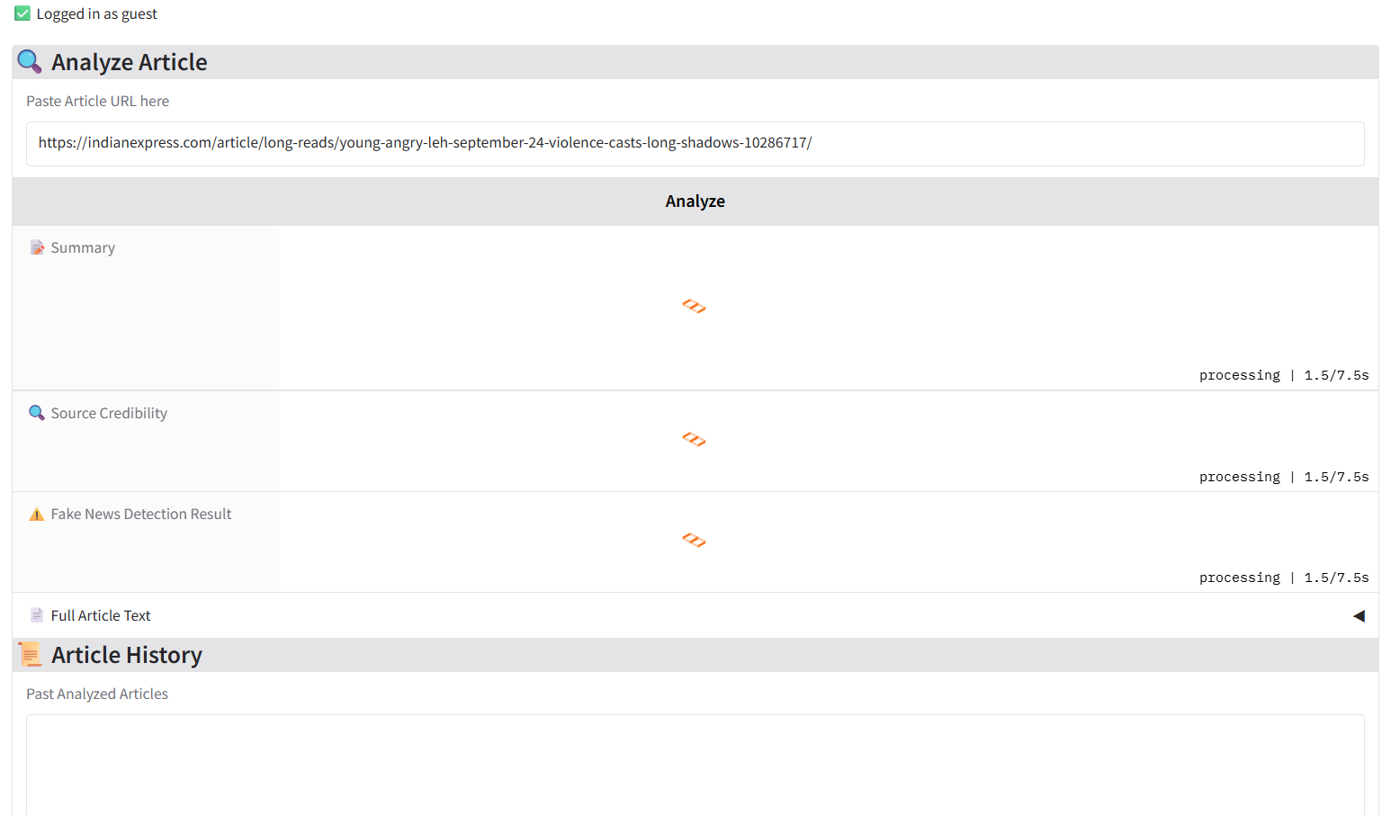
Result
UI and Data Processing Demo Overview

Slide 14
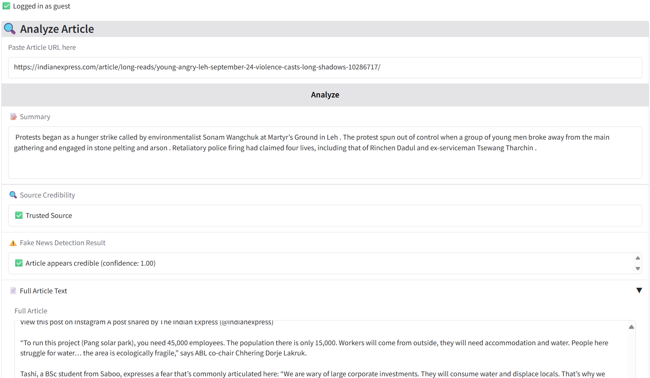
Result
Demo Case 1: System Response to Data from an Trusted Source

Slide 15
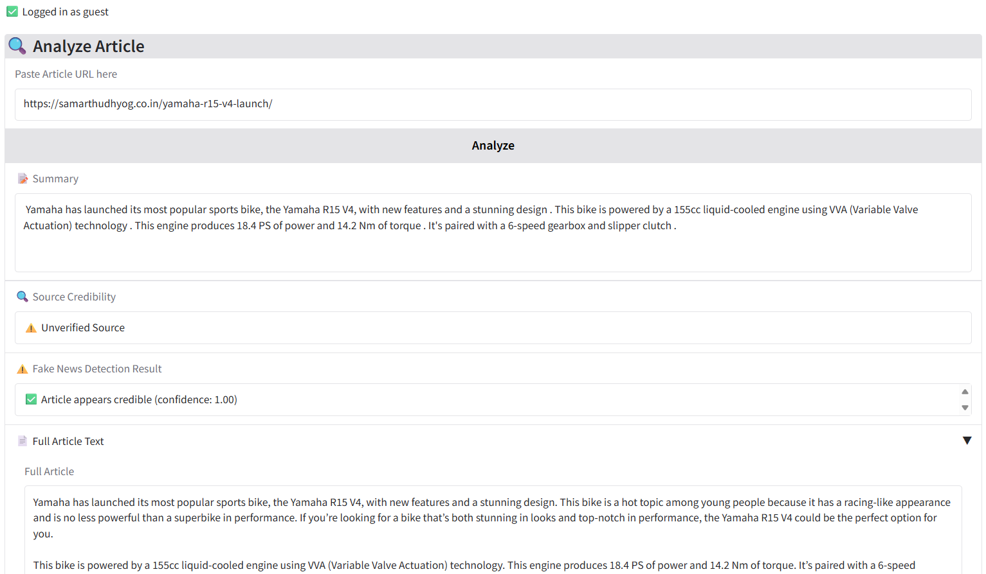
Result
Demo Case 2: System Response to Data from an Untrusted Source

Slide 16
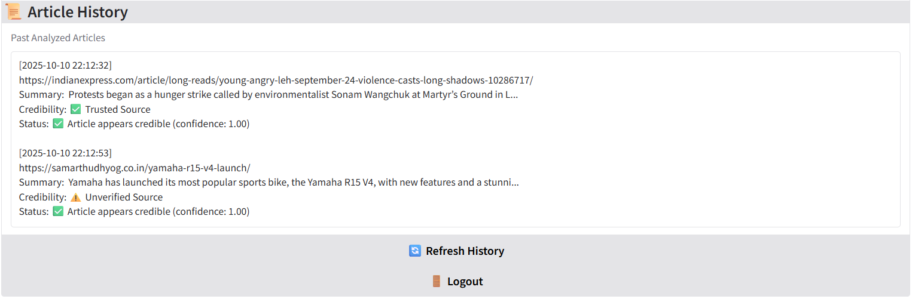
Result
Demo Case: Retrieving and Displaying Browsing History

Slide 17
GITHUB AND DEPLOYMNET LINK
Attach your Github Link :
https://github.com/rohanrodu/Fake-News-Detector-for-Students.git
Deployment link:
https://huggingface.co/spaces/Rodu17/fake-news_detector
(username : guest/admin :: password : guest/admin123)

Slide 18
Conclusion
The development of the Fake News Detection System represents a significant step toward promoting media literacy and combating misinformation. By combining NLP models with a user-friendly Gradio interface, the system allows users to quickly summarize articles, check source credibility, and detect potential fake news in real time. This approach makes information verification faster, simpler, and more accessible for students and the general public.
The project demonstrates how AI-powered tools can support informed decision-making and build trustworthy digital ecosystems.

Slide 19
Future scope
User Authentication, Model Improvement, Source Reputation Engine, Persistent Storage
Voice Integration – Speak URL and get results.
Multilingual Support – Expand model for regional languages.
Mobile App – Responsive mobile UI or Android app.
Data Analytics – Track trending fake news topics.
Advanced Models – Integrate larger LLMs for better accuracy.

Slide 20
References
D. Kaliyar, A. Goswami, and P. Narang, “A survey on fake news detection: Datasets, methods and future research directions,” Information Processing & Management, vol. 58, no. 6, 2021.
Hugging Face, “sshleifer/distilbart-cnn-12-6,” [Online]. Available: https://huggingface.co/sshleifer/distilbart-cnn-12-6
Hugging Face, “mrm8488/bert-tiny-finetuned-fake-news-detection,” [Online]. Available: https://huggingface.co/mrm8488/bert-tiny-finetuned-fake-news-detection
Gradio Documentation, “Gradio: Build & share ML apps,” [Online]. Available: https://www.gradio.app

Slide 21
THANK YOU

